Slide 1

MINI-ME and LabVIEW
Advanced Automated Command Control
Samantha Sanders
Code 691
Dr. John Keller, Dr. Mike Collier, Jacob Hageman

Slide 2

Application: MINI-ME
Miniature Imager for Neutral Ionospheric atoms and Magnetospheric Electrons
Low energy neutral atom imager
MINI-ME was delivered to the USNA team in Huntsville in early August

Slide 3

What is LabVIEW?
LabVIEW is a software program designed to run a graphical programming language representative of more traditional programming languages that enables easy data acquisition, instrument control, and industrial automation.

Slide 4
So you know what I did last summer…
Early stages of instrument development
Goal – develop accessible interface for automatic testing and tracking
Track counts, track voltages

Slide 5
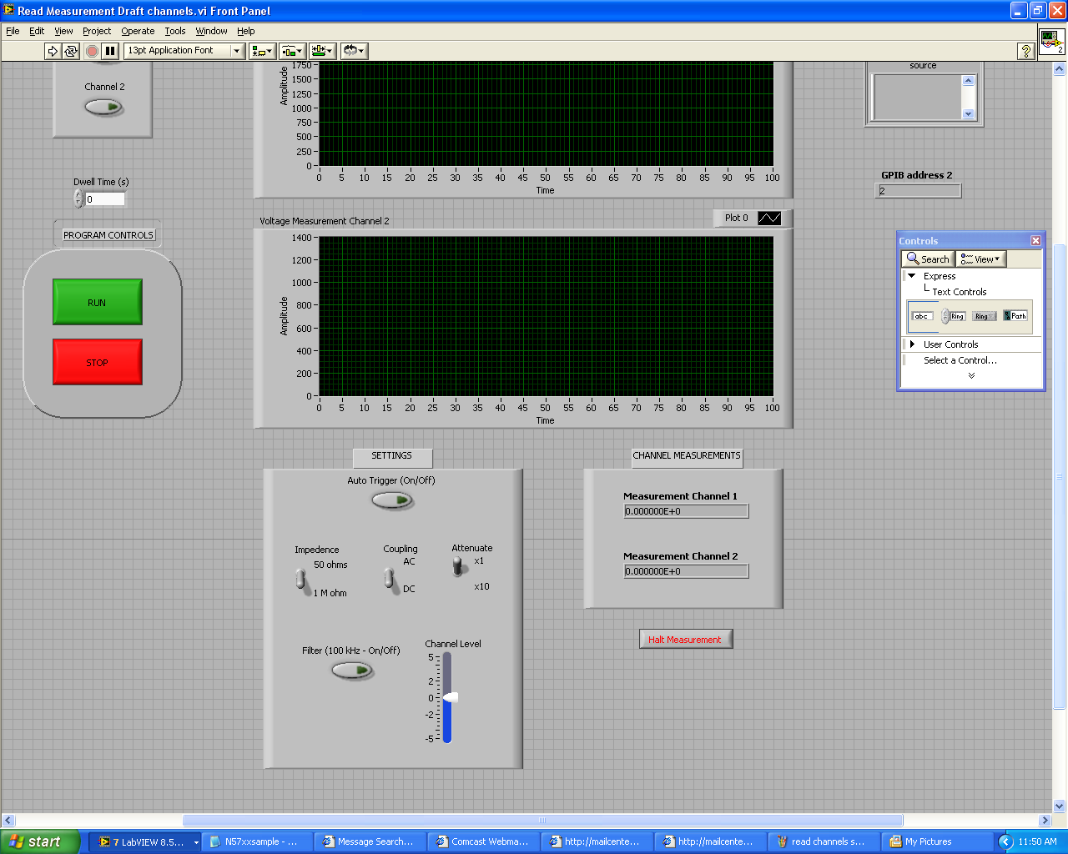
Control Panel

Slide 6
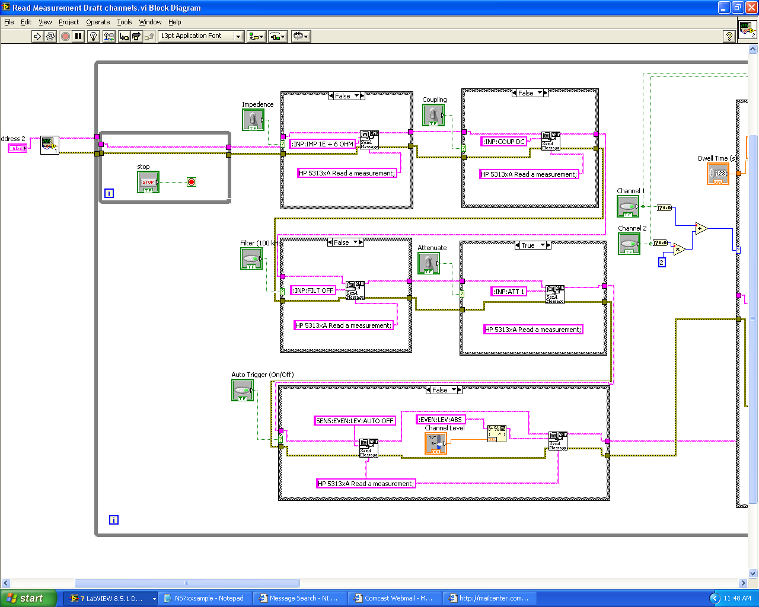
Behind the Scenes - Instruments

Slide 7
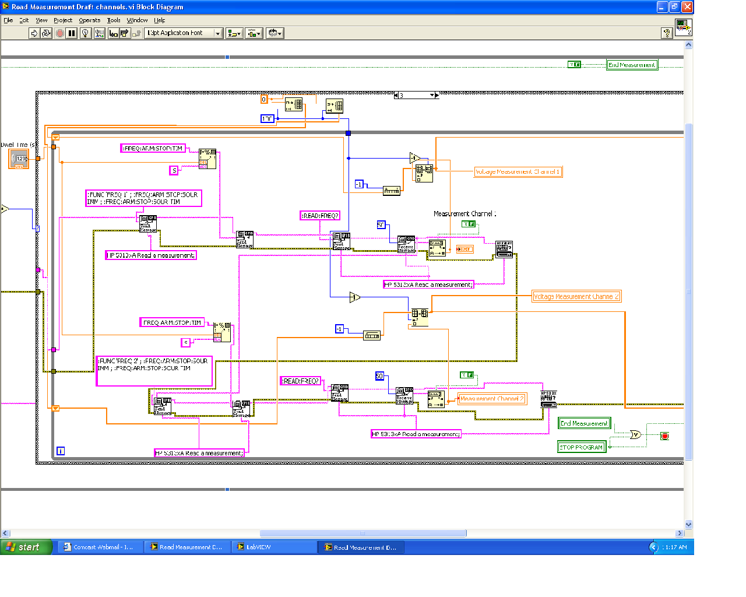
Behind the Scenes - Processing

Slide 8
New Goals
Moving ahead with advanced instrument controls
Processing and converting PERL commands
UNIX-based socket interface
Communication between advanced commands and the instrument hindered by manual command structure

Slide 9
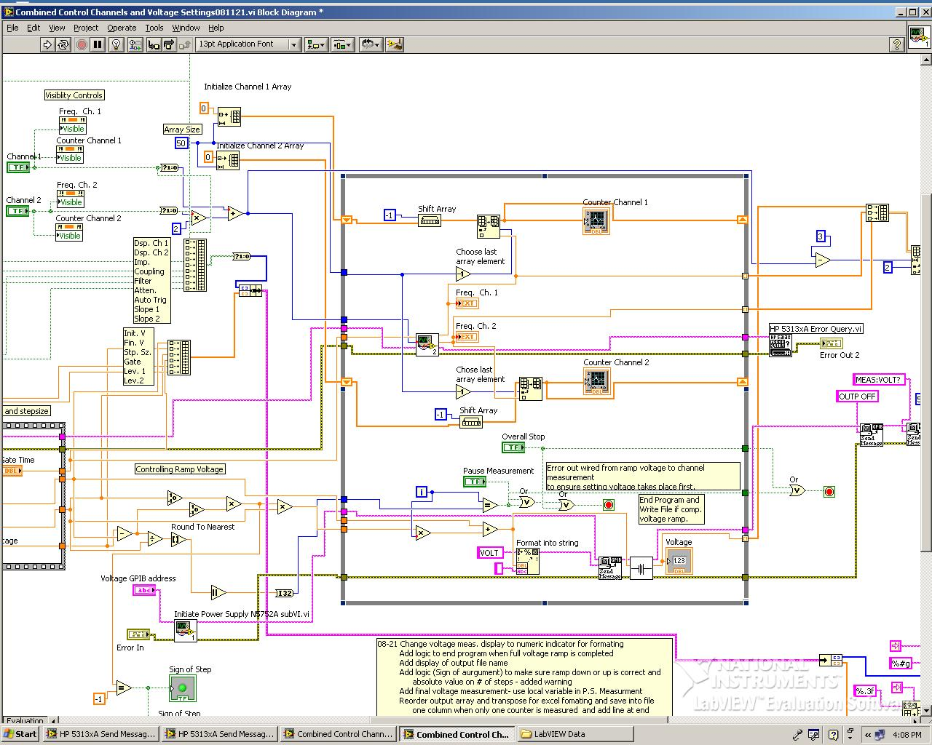
Difficulties of Current Format

Slide 10
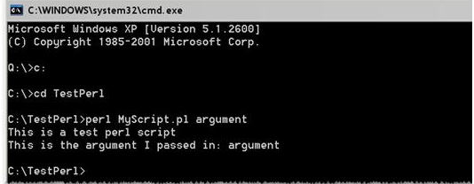
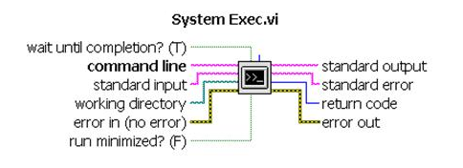
PERL in LabVIEW

Slide 11
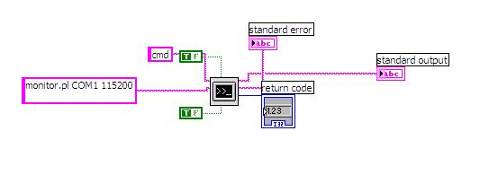
Combining Commands and Controls

Slide 12
Acknowledgements
Thanks to Dr. John Keller and Dr. Mike Collier of Goddard for all of their help and support
Thanks to Jacob Hageman of Goddard for programming assistance
Thanks to Cori Quirk and the SESI Program for another great summer

